Slide 1
Survey of IoT Ecosystem
Group 1 –
Hamza Karachiwala
Hiranava Das
Rahul Bobhate
Sharique Hussain
Suryansh Singh

Slide 2
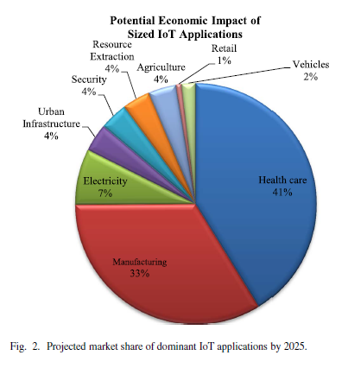
Why have this survey?
Scope of IoT
Horizontal and vertical markets
Vast field
Devices, applications and communication
Architectures, protocols and standards
Challenges and research
Security, trust, management
Market Value
Massive growth projection
$3 trillion - $6trillion value by 2025

Slide 3
We will cover
Architecture - Hamza
Elements - Hiranava
Protocols –
Application-Sharique
Service Discovery-Suryansh
Infrastructure-Hiranava
Others-Hiranava
Research Challenges - Suryansh
Big data - Rahul
Horizontal integration- Sharique

Slide 4
IoT : Survey of Enabling Tech, Protocols, Applications
Al-Fuqaha, Guizani, Mohammedi, Aledhari, Ayyash
IEEE COMMUNICATION SURVEYS & TUTORIALS
2015

Slide 5
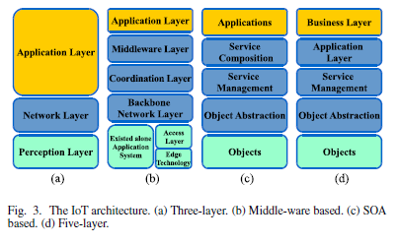
Architecture

Slide 6
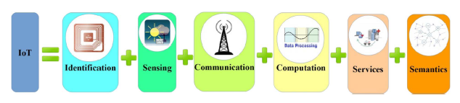
IoT Elements

Slide 7
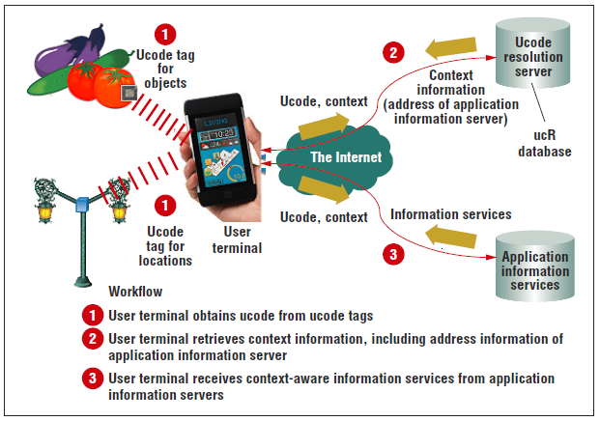
Identification
Unique identification is important to match service with demand.
electronic product codes and ubiquitous codes are available.
Understanding the difference between network address and object ID is important.
Together the object ID and network address helps uniquely identifying an IoT object.
Ubiquitous ID: Standards for Ubiquitous Computing and the Internet of Things Noboru Koshizuka and Ken Sakamura

Slide 8
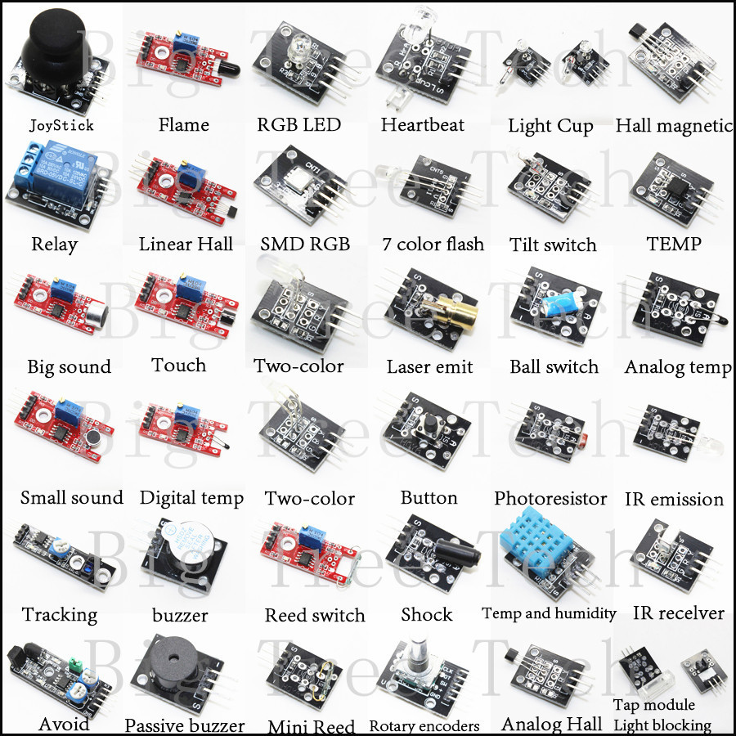
Sensing
IoT sensing is collections of similar data from different sensors and sending the information to data warehouse, database or cloud.
The collected data is analyzed and actions are taken accordingly.
Single Board Computers (SBCs) integrated with sensors, TCP/IP and security functionalities together make an IOT device

Slide 9
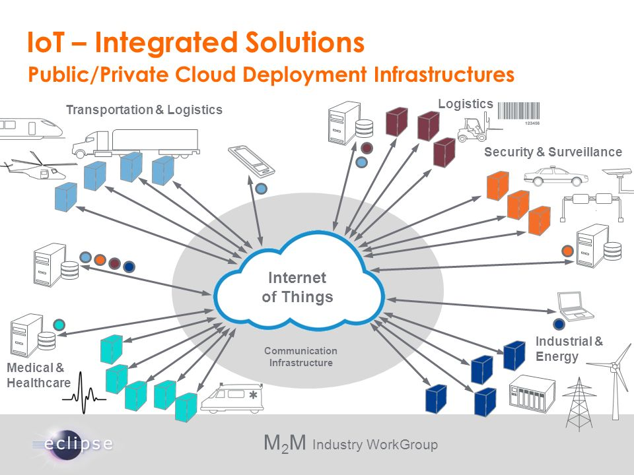
Communication
IoT communication faces mainly two challenges
Connecting varied types of IoT objects
Consuming very less power
Different technologies for IoT communication are
RFID tag and reader realizes the M2M concept.
NFC and Ultra wide bandwidth.
Bluetooth 4.1 or Bluetooth Low Energy.
Wi-Fi using radio waves and router.
LTE the standard protocol for high speed data transfer in mobile phones.

Slide 10
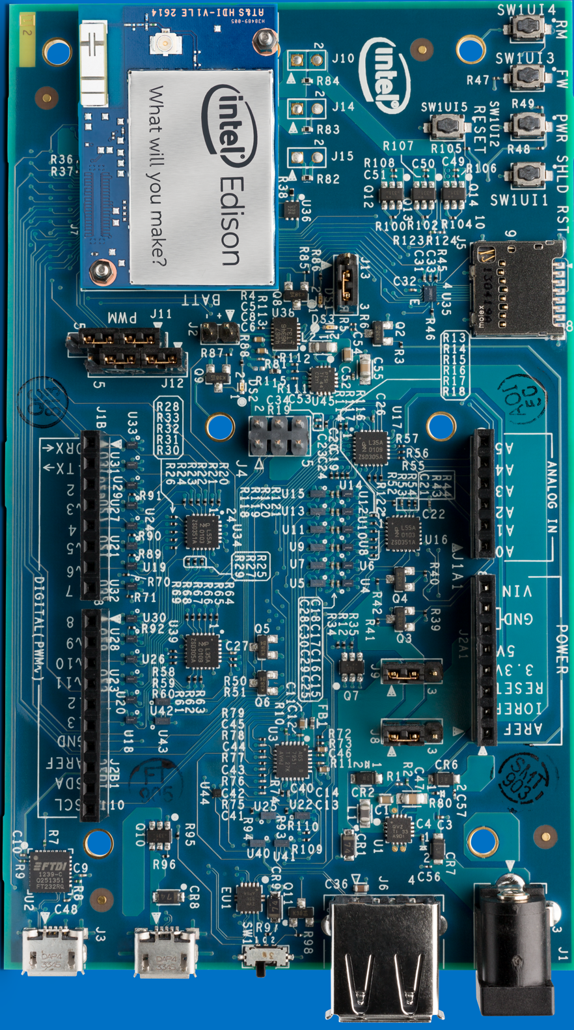
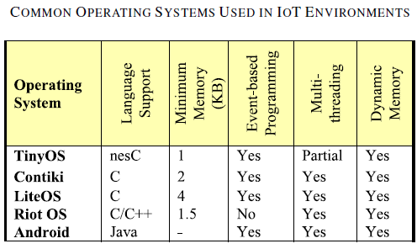
Computation
The “brain” of an IoT object.
Different hardware are available in market like Arduino, Intel Edison etc.
Operating system running on these hardware is of crucial importance
Cloud platform is also an important part of computation. It facilitates collection and processing of big data.

Slide 11
Services
Identity related services – to identify real life objects in virtual world.
Information aggregation services – collect and summarize raw sensory data.
Collaborative-Aware services – make decisions and respond.
Ubiquitous services – any time, anyone and anywhere.
Smart home, Smart buildings, Intelligent Transport System, Industrial Automation, Smart Healthcare and Smart Grids.

Slide 12
Semantics
To make a sense from the gathered information and provide services accordingly.
Discovering and using resources
Recognizing and analyzing data to make the right decision
Efficient XML Interchange (EXI) converts XML to binary.

Slide 13
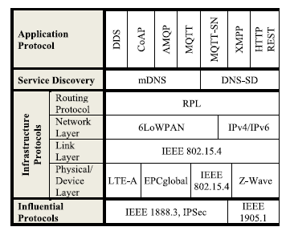
Protocols

Slide 14
Challenges
Availability
Access to hardware and software
Reliability
Dependability of hardware and software
Mobility
Delivery and management
Performance
Components and protocols
Management
Light weight FCAPS of billions of devices
Interoperability
Applications and devices
Security and Privacy
CIA among smaller devices

Slide 15
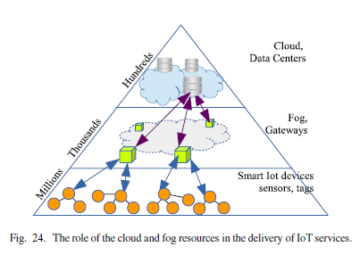
Big Data, Cloud and Fog
Analytics in real time on big data
Time Series Database (Modified Hadoop at FB)
Cloud Computing
Challenges and Platforms (Xively Nimbits)
Fog Computing
Cloudlet or edge computing improving interaction with cloud

Slide 16
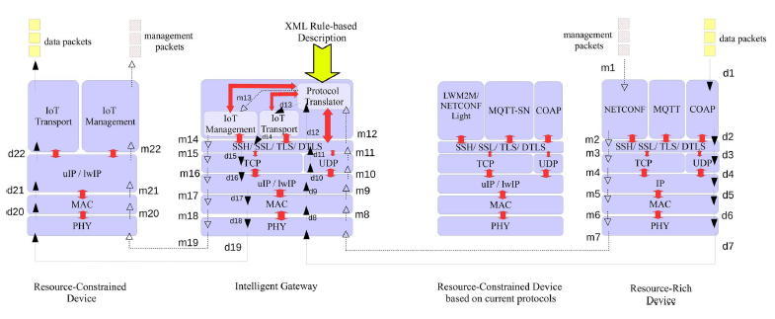
Horizontal Integration between Application Protocols

Slide 17
Thank You!

